Slide 1
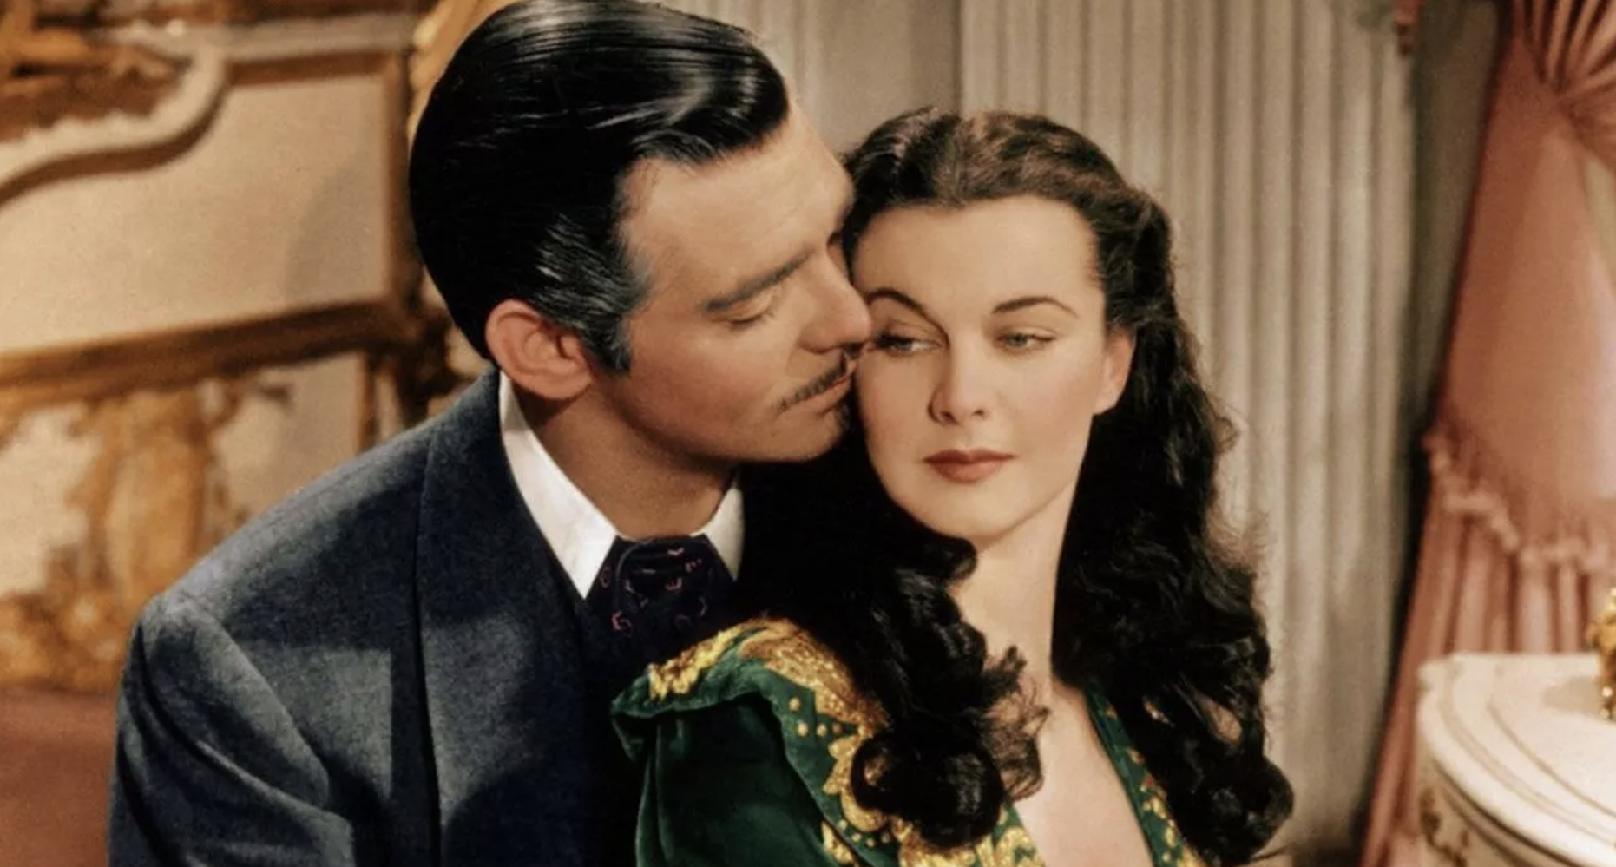
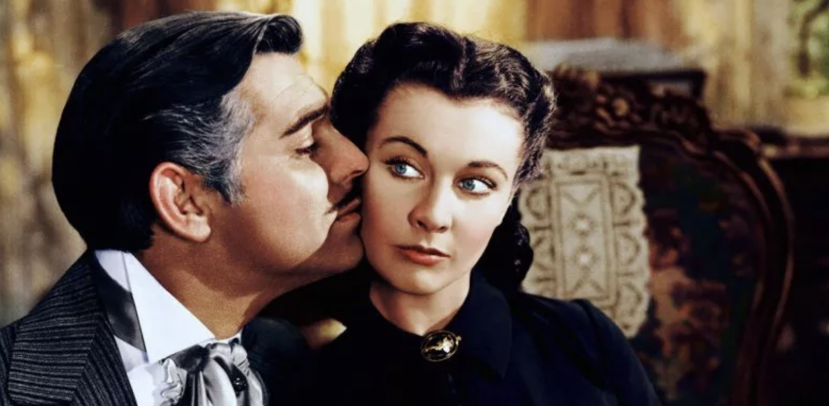
A New Mathematical Model of
‘‘Gone with the Wind’’
MATH 142 Project
Group Member:
Hung-yu Chen, Yue Yang, Zhiqi Ma, Zhihan Chen
Notes:
Hi everyone, today we are going to talk about the new mathematical model of “Gone with the Wind” base on the paper we read.

Slide 2
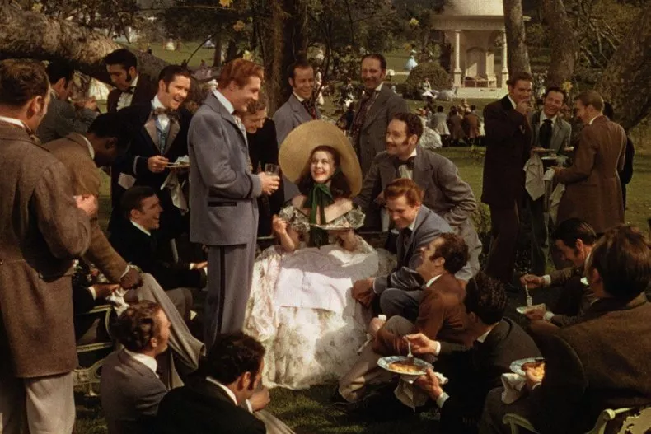
Roadmap
Background
Introduction of Old Model
Limitation & Improvement
Notes:
For the first part, I am going to give a brief introduction on the background.

Slide 3
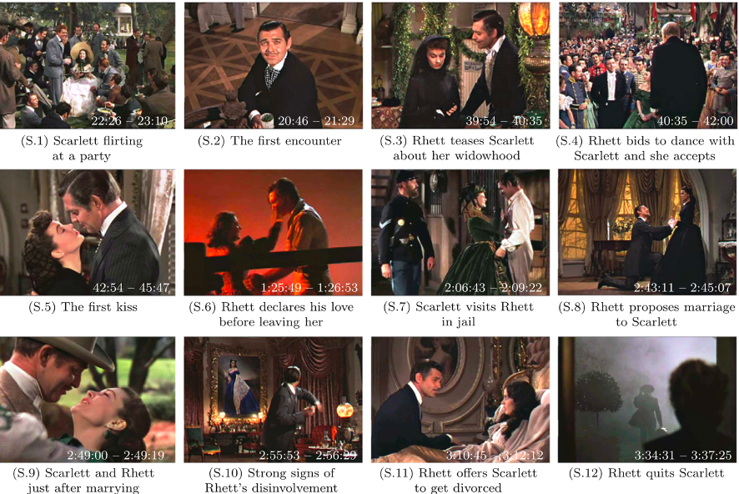
Background
Our project is based on the paper about the math model of love between Scarlett and Rhett in the film ‘Gone with the wind’. In the original paper, the authors summarize the plot in 12 scenes, represented by the following 12 screenshots.
Notes:
So Our project is based on the paper about the math model of love between Scarlett and Rhett in the film ‘Gone with the wind’. In the original paper, the authors summarize the plot in 12 scenes, represented by the following 12 screenshots.
Scarlett and Rhett met at the party. Rhett fells in love with Scarlett, but Scarlett refused him because she was so in love with Ashley. After Rhett saved Scarlett from the war in Atlanta, Scarlett again refused him and went back home and found out that her family was destroyed by the war. The next time when they met each other long time after that. They got married because Scarlett needed Rhett’s money. They built a home and earned a lot of money. But their marriage got destroyed by the relationship between Scarlett and Ashley.
S. 1: Scarlett flirting at a party.
S. 2: Scarlett and Rhett meet each other for the first time at the party.
S. 3: A year after the party, Scarlett and Rhett meet again at a dancing party organized for raising money for the Confederate Cause. It is also when Scarlett has just lost her first husband, Charles, and Rhett is teasing at her for being a widow.
S. 4: At the dancing party, in order to raise funds, the organizer announces the auction of the right to dance with the ladies. Rhett immediately bids $150 for Scarlett, and Scarlett agrees.
S. 5: To induce Scarlett to take off her black veil, Rhett buys her a green bonnet. She can’t resist the fashionable bonnet, but she warns him that she won’t marry him in return. He replies that he is not the marrying type but then kisses her for the first time to once again show his involvement.
S. 6: When Atlanta is burning in August 1864, Rhett rescues Scarlett from the Yankees and tells her that he is going to join the Confederate Army. Before he leaves, he tells Scarlett that he truly loves her, but Scarlett is still angry that he abandons her.
S. 7: After the war in 1865, Scarlett became financially difficult due to financial problems arising from the cotton production she owned in Tara. She suddenly thought that Rhett could solve her financial problems and visited Rhett in prison.
S. 8: During Frank's funeral, Rhett proposed to Scarlett, and she agreed, partly driven by Rhett's kiss and his wealth.
S. 9: They have a very happy time after marriage, especially when they have their daughter, Bonnie.
S. 10: One day they have an argument and Scarlett threatens Rhett, saying that she could stop having sex with him. He responded nonchalantly that there are many other women’s beds in the world, implying that he no longer wants to invest in this relationship.
S. 11: One night, Rhett drinks too much at a party and makes violent love with Scarlett after getting back home. The next morning, Rhett apologizes for being drunk and files for divorce from Scarlett.
S. 12: No matter how much Scarlett says she loves him, Rhett ultimately chooses to leave her.
Scarlett and Rhett met at the party. Rhett fells in love with Scarlett, but Scarlett refused him because she was so in love with Ashley. After Rhett saves Scarlett from the war in Atlanta, Scarlett again refused him and went back home and found out that her family was destroyed by the war. The next time when they met each other long time after that. They got married because Scarlett needed Rhett’s money. THey build a home and earned a lot of money. But their marriage got destroyed by the relationship between Scarlett and Ashley.

Slide 4
Roadmap
Background
Introduction of Old Model
Limitation & Improvement
Notes:
And for the next part, I am going to give a brief introduction of the old model from the paper.

Slide 5
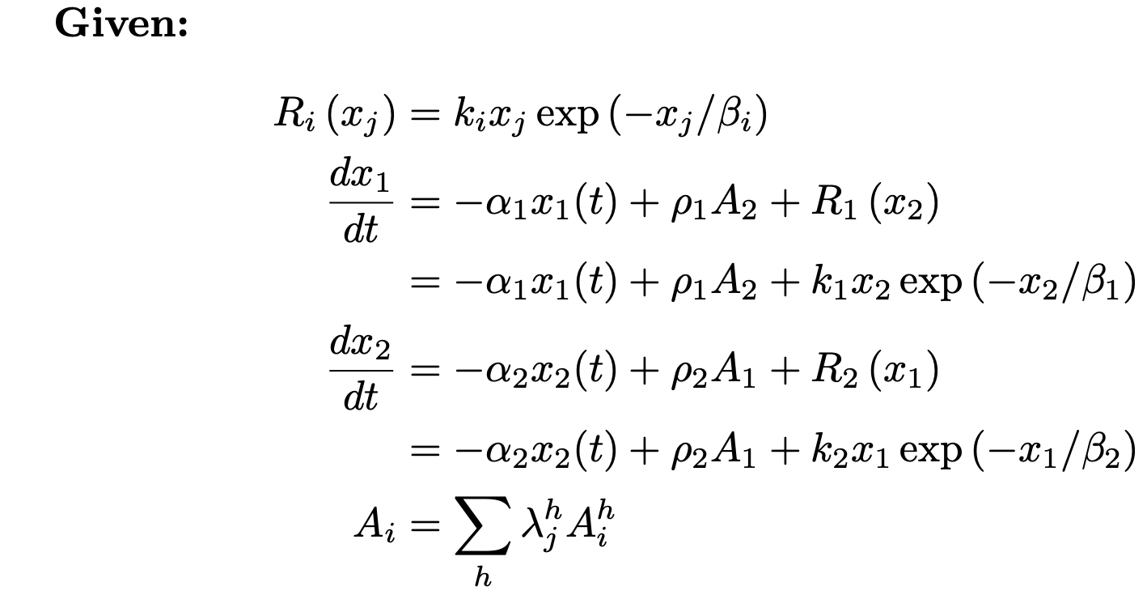
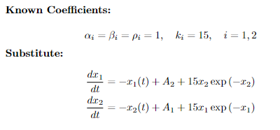
Introduction – Parameter Interpretation
The original model introduced by the author：
Ri(xj) signifies the flow of interest generated in individual i by the love of the partner j.
dxi/dt represents the feeling of individual i for the partner with respect to time.
Ai represents the appeal of individual i, which is a value perceived by the partner j.
αί: forgetting coefficient
⍴ί: the sensitivity of individual i to appeal
βί and kί are two parameters that define the value of Rί
Notes:
On the right side is the original model introduced by the authors. The first equation Ri signifies the flow of interest generated in individual i by the love of the partner j. The second and the third equation, which is the derivative of x1 and x2 with respect to t, represents the feeling of individual i for the partner with respect to time. And finally, the fourth equation Ai represents the appeal of individual i, which is a value perceived by the partner j. Here, Ai^h are the various components of the appeal of individual i, which can include physical attractiveness, intelligence, age, richness, as well as others, which are independent on the feeling Xi for the partner. And 𝜆j^h is the weight that individual j gives to the h-th component of the appeal of his/her partner. So the appeal of individual i perceived by the partner j is defined as the sum of the product of each component of the appeal of an individual and the weight that his/her partner gives to that component.
The author set the coefficients α, β, and ⍴ to be 1 and k to be 15 for both Scarlett and Rhett.
Xi(t) represents the feeling at time t of individual i for the partner
ki and βί in the equation are two parameters that define Ri
The appeal of individual i has various components Ai^h like physical attractiveness, intelligence, age, richness, as well as others, which are independent on the feeling Xi for the partner.
𝜆j^h is the weight that individual j gives to the h-th component of the appeal of his/her partner
So the appeal of i perceived by j is defined as the sum of the product of each component of an individual and the weight that his/her partner gives to the component.

Slide 6
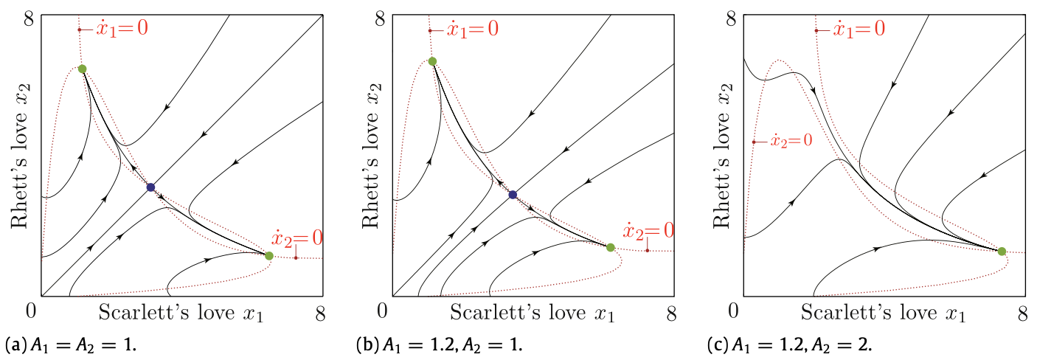
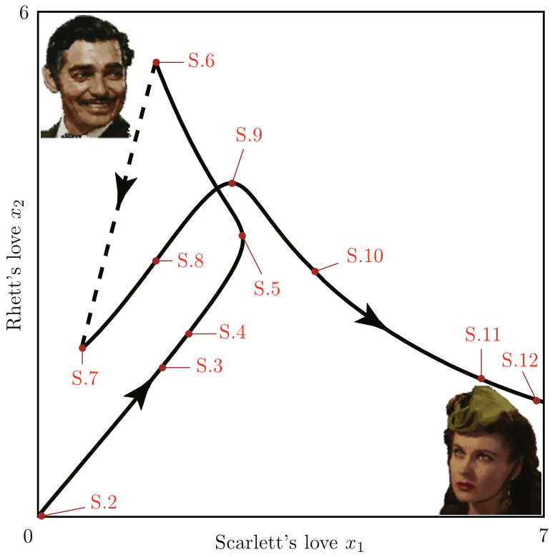
Introduction – Phase Portrait
A1: the appeal of Scarlett
A2: the appeal of Rhett
saddle
The equilibrium points in green are stable.
In the long term, Rhett is much more involved than Scarlett.
The equilibrium point is stable. In the long term, Scarlett is much more involved than Rhett.
Notes:
The authors draw the trajectory based on the far right phase portrait. From S2 to S6, which is the time before the war, the author used the phase portrait in figure b, where starting from the origin, the point will eventually reach the top equilibrium point in green.
From S7 to S12, which is the time after the war, the author used the phase portrait in figure c, and the point will again reach the equilibrium point in green.
By taking different initial values of A1 and A2 in different phases, the authors plot the three phase portraits shown in figure (a), (b), and (c).
Figure (a) is the condition where A1 and A2 are equal and there are three fixed points in the phase portraits where the blue one in the middle is a saddle point and the other two green ones are stable equilibrium points.
But according to the scenes, since Scarlett is more appealing than Rhett before the war, A1 was set to be 1.2 and A2 be 1. Starting from the origin, the point will ultimately reach the top equilibrium point in green, where it is stable and this means that Rhett would be much more involved than Scarlett in the long run.
Finally, in figure (c), since Rhett is more appealing than Scarlett after the war, A1 was set to be 1.2 and A2 be 1. Then
the model predicts that Scarlett would be much more involved than Rhett in the long term.
Putting all the phase portraits together forms the far right figure, which shows the overall evolution model, and the authors conclude that the model accurately predicts the complex evolution of Scarlett and Rhett’s relationship in the film.
The authors draw the trajectory based on the far right phase portrait. From S2 to S6, which is the time before the war, the author used the phase portrait in figure b, where starting from the origin, the point will eventually reach the top equilibrium point in green.
From S7 to S12, which is the time after the war, the author used the phase portrait in figure c,

Slide 7
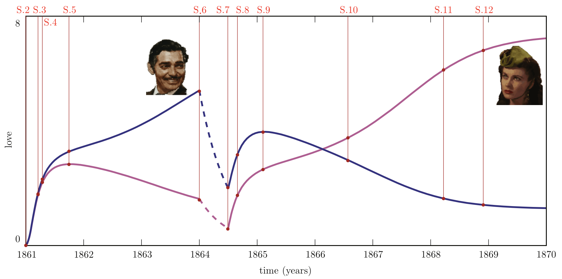
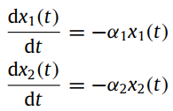
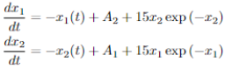
Introduction – Trajectory

Slide 8
Roadmap
Background
Introduction of Old Model
Introduction of Old Model
Limitation & Improvement
Notes:
Now, let’s introduce the old model from the paper.

Slide 9
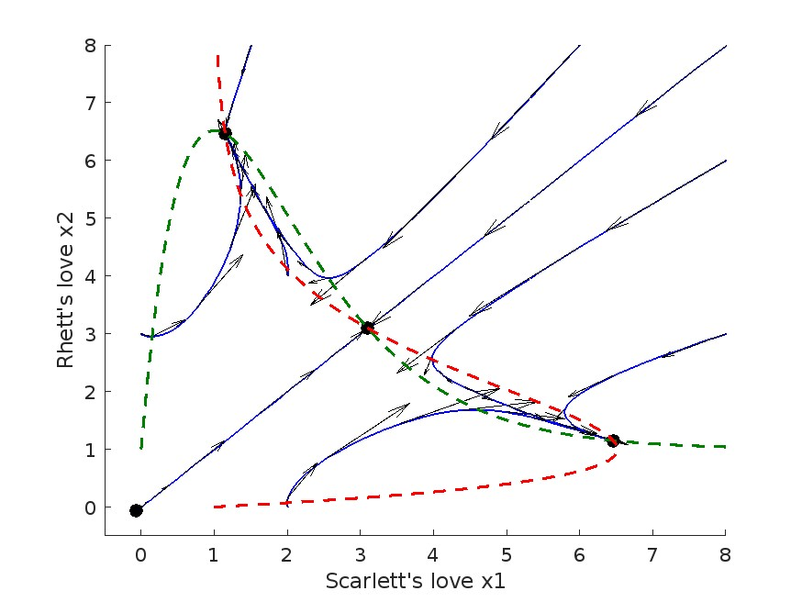
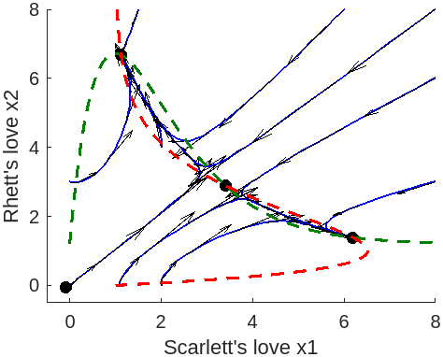
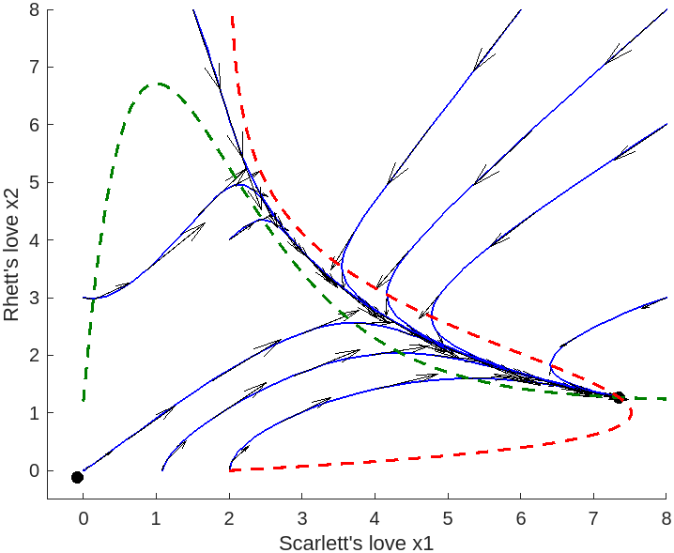
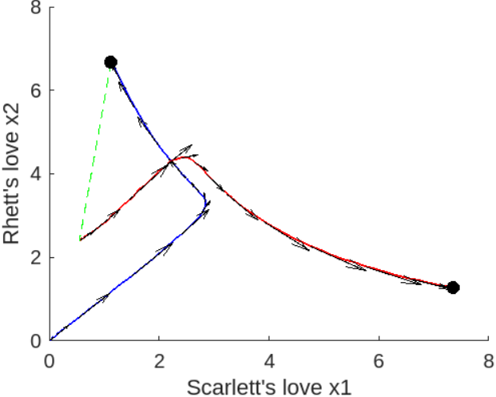
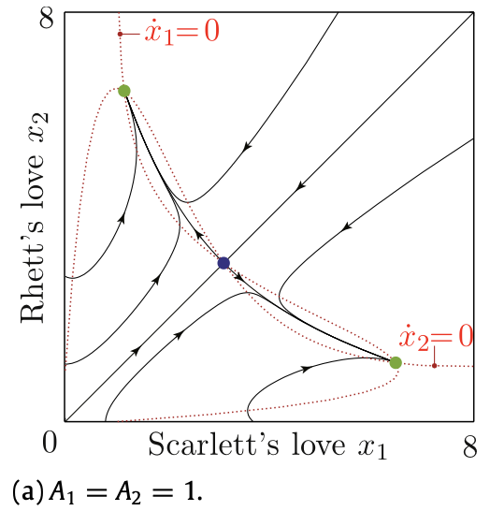
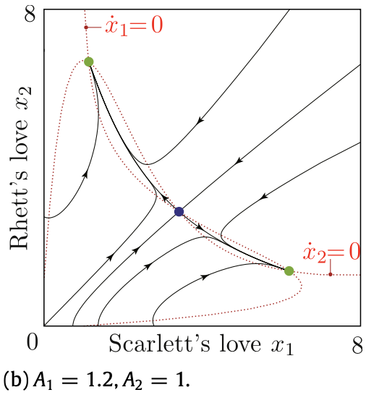
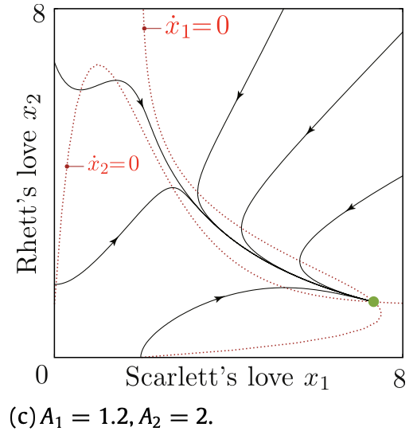
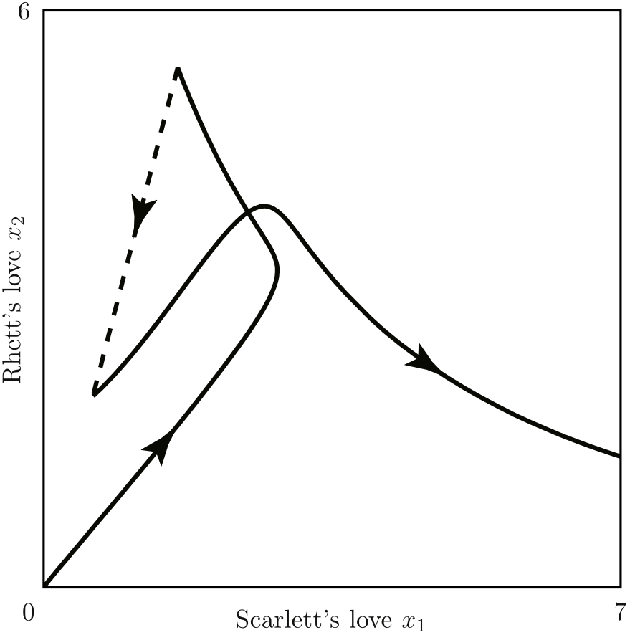
Limitation & Improvement
Limitation 1: Did not give the code for phase portraits and trajectories.
Improvement 1:
Paper Plot 👇
Plot by our code 👆

Slide 10
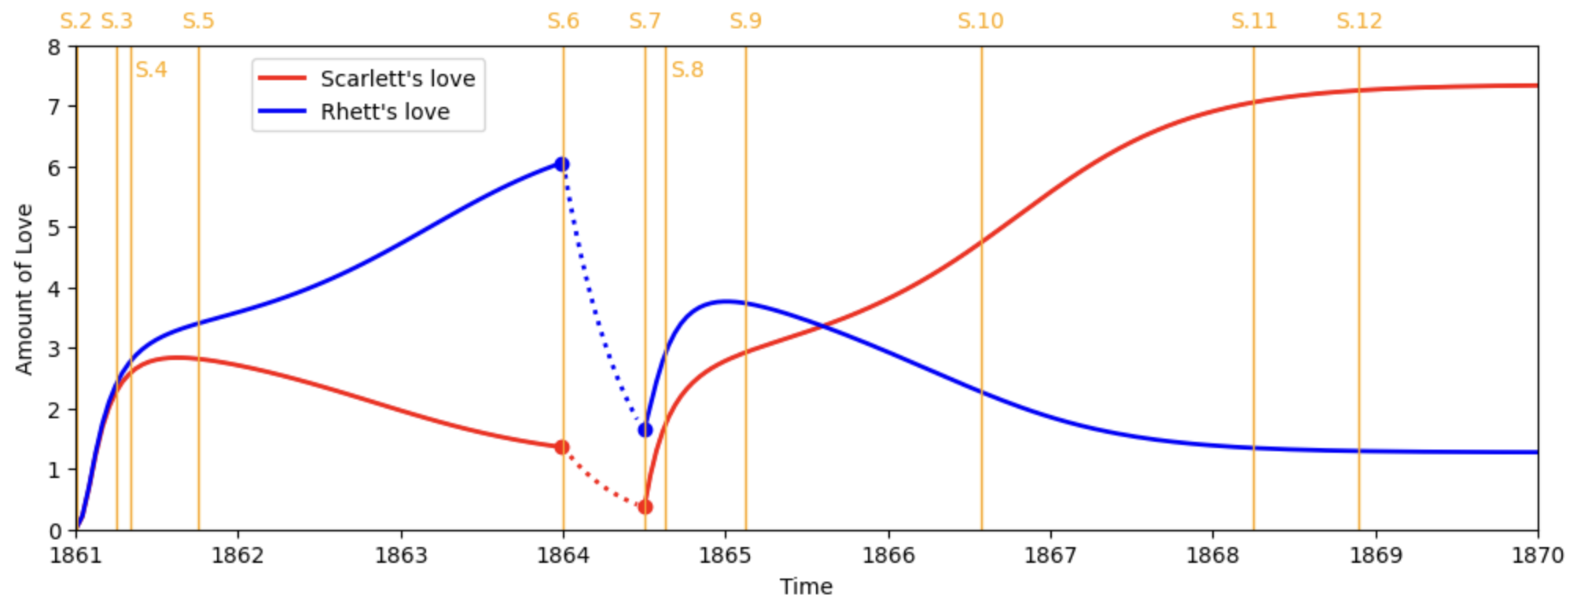
Limitation & Improvement
Limitation 1: Did not give the code for phase portraits and trajectories.
Improvement 1:
Plot by our code 👇

Slide 11
Limitation & Improvement
Limitation 1: Did not give the code for plotting phase portraits and trajectories.
Improvement 1:
Plot from the paper👇

Slide 12
Limitation & Improvement
Limitation 2: Lack of important plots in the movie
The authors use 12 scenes in their model’s plot as a reference.
Improvement 2:
Plots we’ve added:
S.6.5: Scarlett is grateful that Rhett rescued her from the Yankees, especially if we consider the hardship of this escape.
S.7.5: Scarlett marries Frank after her visit with Rhett in the jail. Frank dies in a subsequent incident some times later, and Scarlett is again widowed.
S.10+:
There is an ‘argument’ between Scarlett and Rhett.
One day, Scarlett comforts Ashley after he expresses his desire to return to a simpler life. Ashley's sister, India, overhears this, and spreads the rumor that Scarlett seduced a married man and dishonors her, leading to Rhett’s embarrassment and anger.
Notes:
S married F, and dies. The reason of the argument is the rumors of the relationship between S and A

Slide 13
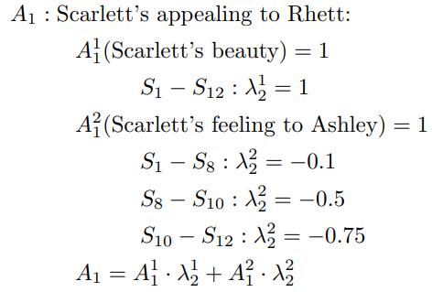
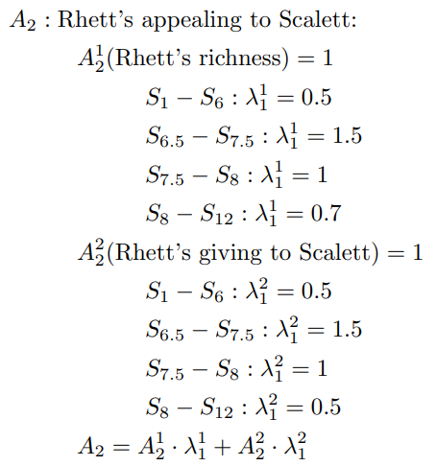
Limitation & Improvement
Limitation 3: Did not give the value of each λί and indicate how each Aί is calculated
Improvement 3:
Assign reasonable values to Ai and 𝝀i to the old model
Based the new sets of pivotal scenes, we separated the scenes into 7 parts
Each part with different 𝝀, which leads to different A1 and A2 (explained later)
Assign new components to A1 and A2
Old model:
New model:
Notes:
Since we added pivotal scenes, we are able to separated the scenes into 6 parts. The old model only has 3 parts.

Slide 14
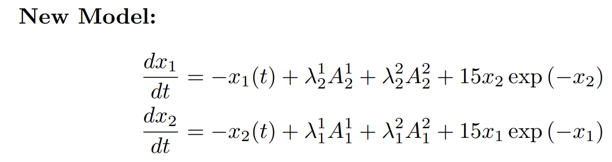
Limitation & Improvement
Limitation 3: Did not give the value of each λί and indicate how each Aί is calculated
Improvement 3:
Therefore, the ODE system is changed to:
Notes:
The forgetting function and the insecure function is not changed

Slide 15
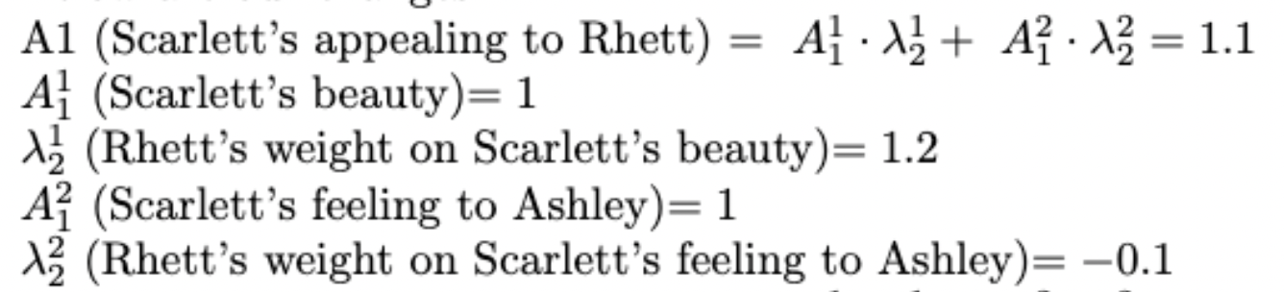
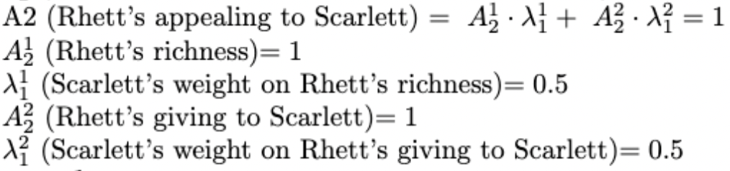
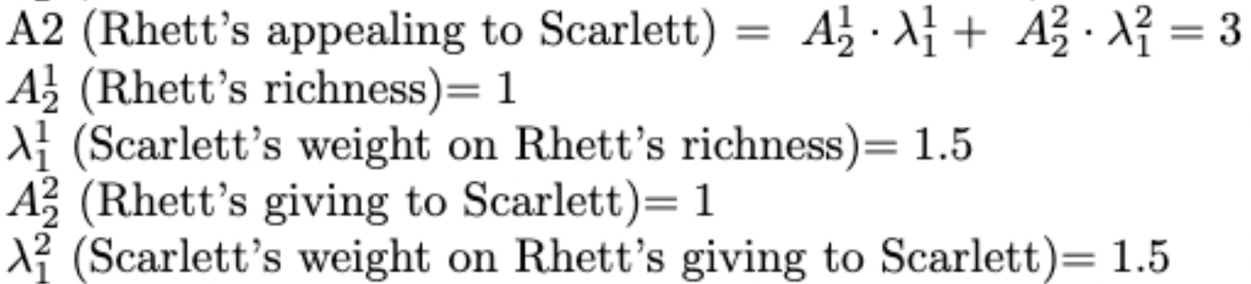
Limitation & Improvement
Limitation 3: Did not give the value of each λί and indicate how each Aί is calculated
Improvement 3: Change 𝝀 based on the new scenes
Part 1: S.2 - S.6
Part 2: S.6 - S.6.5
Notes:
S’s condition changed from a rich and loved girl to a lost woman in the war. The weight of R’s appealing factor given by S increases from 0.5 to 1.5.

Slide 16
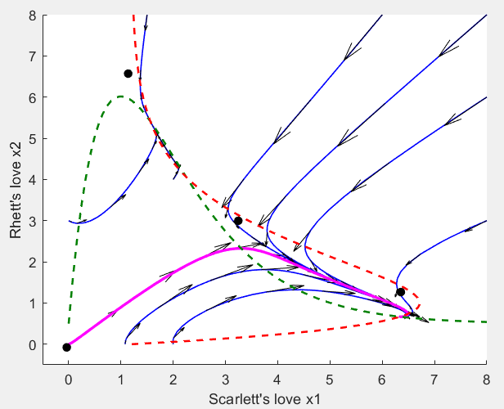
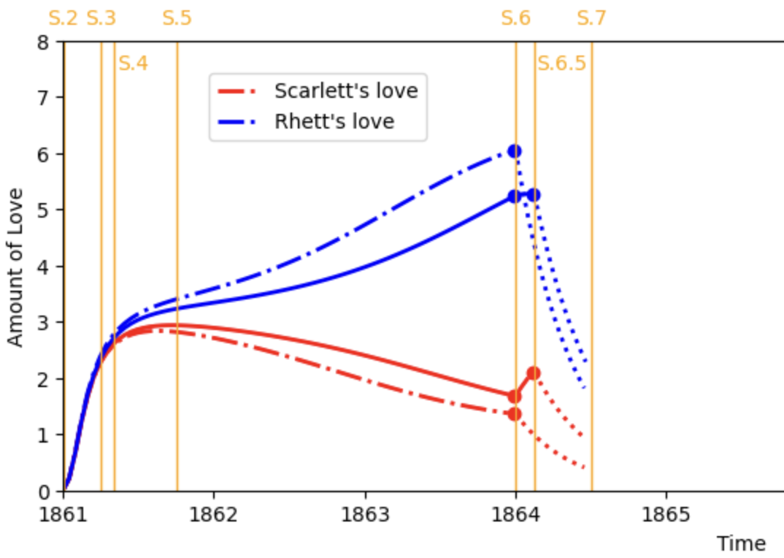
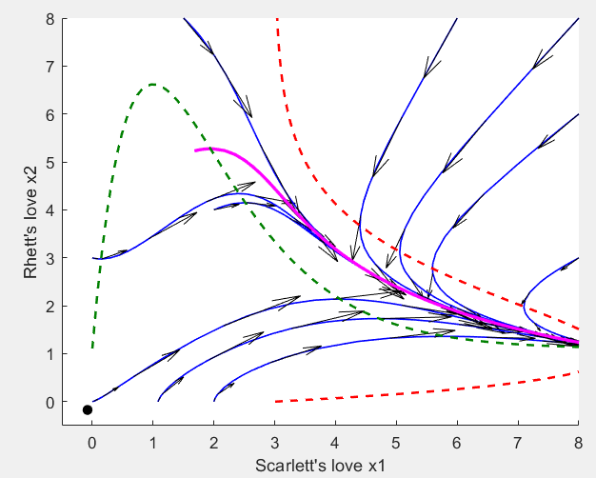
Limitation & Improvement
Limitation 3: Did not give the value of each λί and indicate how each Aί is calculated
Improvement 3: Change 𝝀 based on the new scenes
Part 1&2: S.2 - S.6 - S.6.5
S2-S6
S6-S6.5
Notes:
These are the phase portrait and trajectories in these two periods.
The dotted lines - old model The continuous lines - new model S2-S6: Rhett’s love is lower in the new model, S’s love is higher in the new model S6-S6.5: Since we added a new plot, the start time of the purely forget function is delayed. R’s love remains the pattern, but S’s love suddenly increases

Slide 17
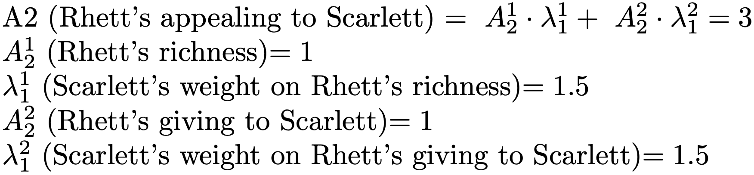
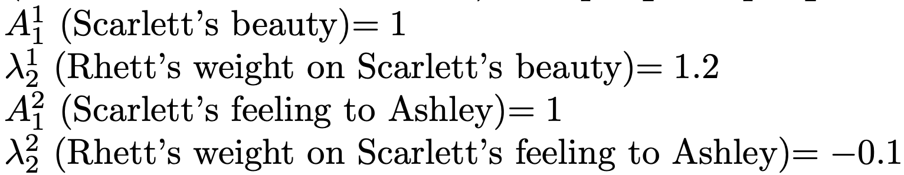
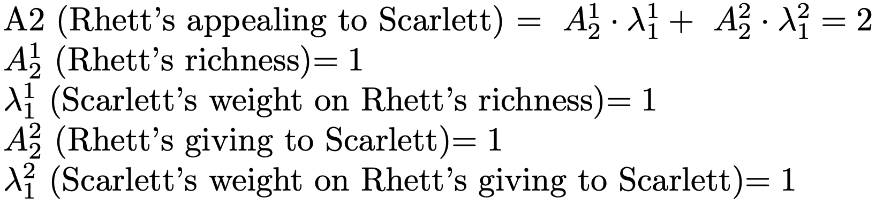
Limitation & Improvement
Limitation 3: Did not give the value of each λί and indicate how each Aί is calculated
Improvement 3: Change 𝝀 based on the new scenes
Part 3: S.7 - S.7.5
Part 4: S.7.5 - S.8
Notes:
Part 3 begins with S7 - when the Civil War ends; Scarlett is in bad financial condition related to problems of her plantation Tara, so she wants Rhett to lend her money to save Tara.
At the beginning of part 4, which is S7.5, as explained previously, Scarlett marries Frank who runs a successful business, and she becomes wealthy again.
As a result, the weights Scarlett assigns to both Rhett’s richness and giving for part 3 are still high and then we decrease them in part 4, so A2 is 3 in part 3 and 2 in part 4.
But Scarlett’s appealing to Rhett is the same as in part 2 and does not change in both part 3 and 4.

Slide 18
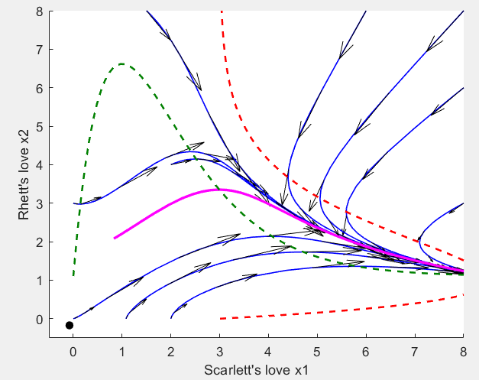
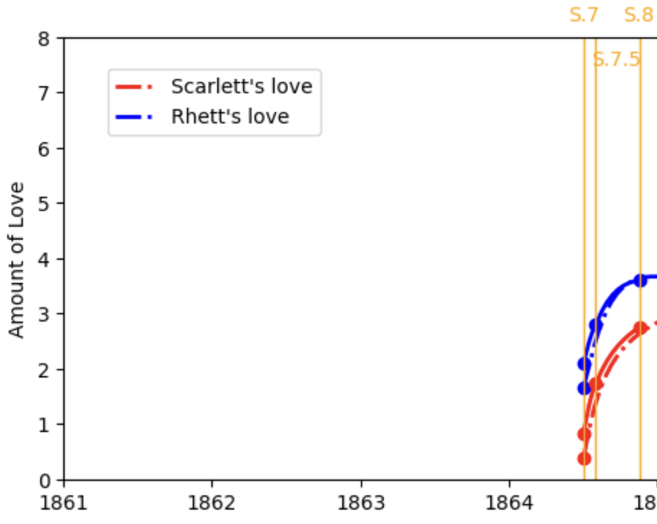
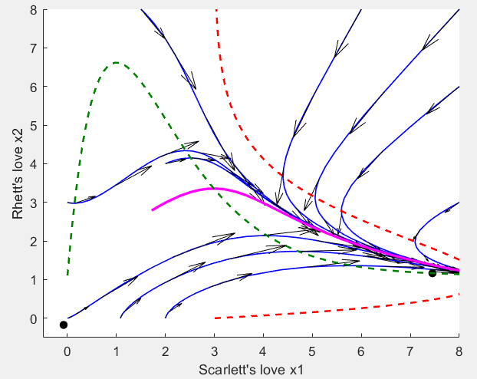
Limitation & Improvement
Limitation 3: Did not give the value of each λί and indicate how each Aί is calculated
Improvement 3: Change 𝝀 based on the new scenes
Part 3&4: S.7 - S.7.5 - S.8
S7-S7.5
S7.5-S8
Notes:
The trajectory of our new model does not change a lot compared with the old one, so it seems that the old model is quite valid in part 3 and 4.

Slide 19
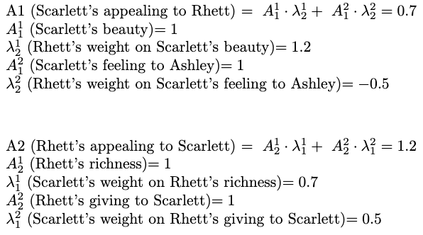
Limitation & Improvement
Limitation 3: Did not give the value of each λί and indicate how each Aί is calculated
Improvement 3: Change 𝝀 based on the new scenes
Part 5: S.8 - S.10
Notes:
Scarlett’s new husband Frank dies later in an incident, which leads to Scarlett’s marriage with Rhett. Their marriage has a big impact on our new model.
We increase the magnitude of Rhett’s weight on Scarlett’s feeling to Ashley since it’s reasonable for a husband to care about whether there is ‘the other man’ in his marriage. Now A1 becomes 0.7 rather than 1.1 in previous parts.
Also, since Scarlett has both plenty of money and love from Rhett, so we decrease the weight she assigns to Rhett’s richness and giving. Now A2 changes from 2 to 1.2.

Slide 20
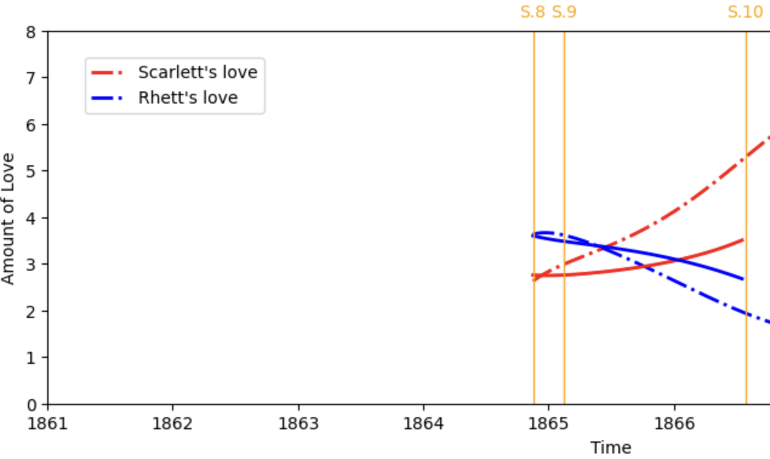
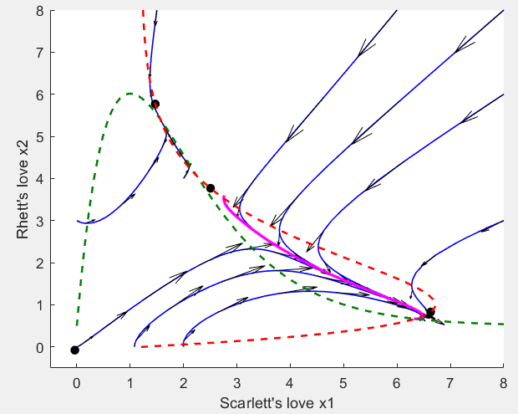
Limitation & Improvement
Limitation 3: Did not give the value of each λί and indicate how each Aί is calculated
Improvement 3: Change 𝝀 based on the new scenes
Part 5: S.8 - S.10
S8-S10
Notes:
The trajectory of our model is smoother during this interval, which is more accurate since there are not many changes for Scarlett and Rhett’s feelings towards each other at this time.

Slide 21
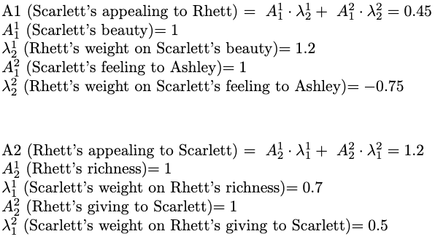
Limitation & Improvement
Limitation 3: Did not give the value of each λί and indicate how each Aί is calculated
Improvement 3: Change 𝝀 based on the new scenes
Part 6: S.10 - End
Notes:
In the final part, we decrease the value of A1 again since Rhett finds evidence that Scarlett is still in love with Ashley, Now A1 decreases from 0.7 to 0.45.
While Rhett’s appealing to Scarlett does not change.

Slide 22
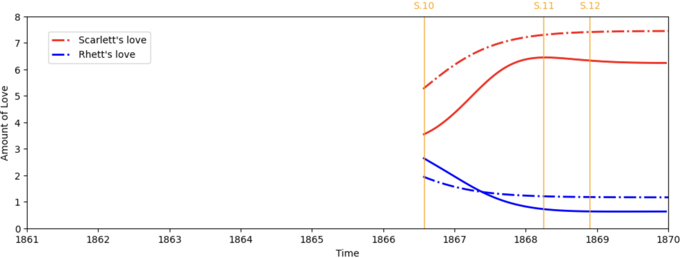
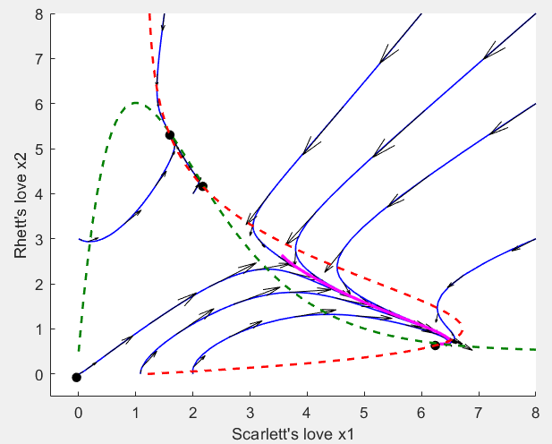
Limitation & Improvement
Limitation 3: Did not give the value of each λί and indicate how each Aί is calculated
Improvement 3: Change 𝝀 based on the new scenes
Part 6: S.10 - End
S10-End
Notes:
The overall trend of new model is similar to the old one, except that there is a slight decrease of Scarlett’s love to Rhett around S11, which can not be recognized in the old trajectory.
At that time Scarlett falls down the stairs and has a miscarriage during an argument with Rhett, which decreases her love to him, and which shows that our model is more accurate.

Slide 23
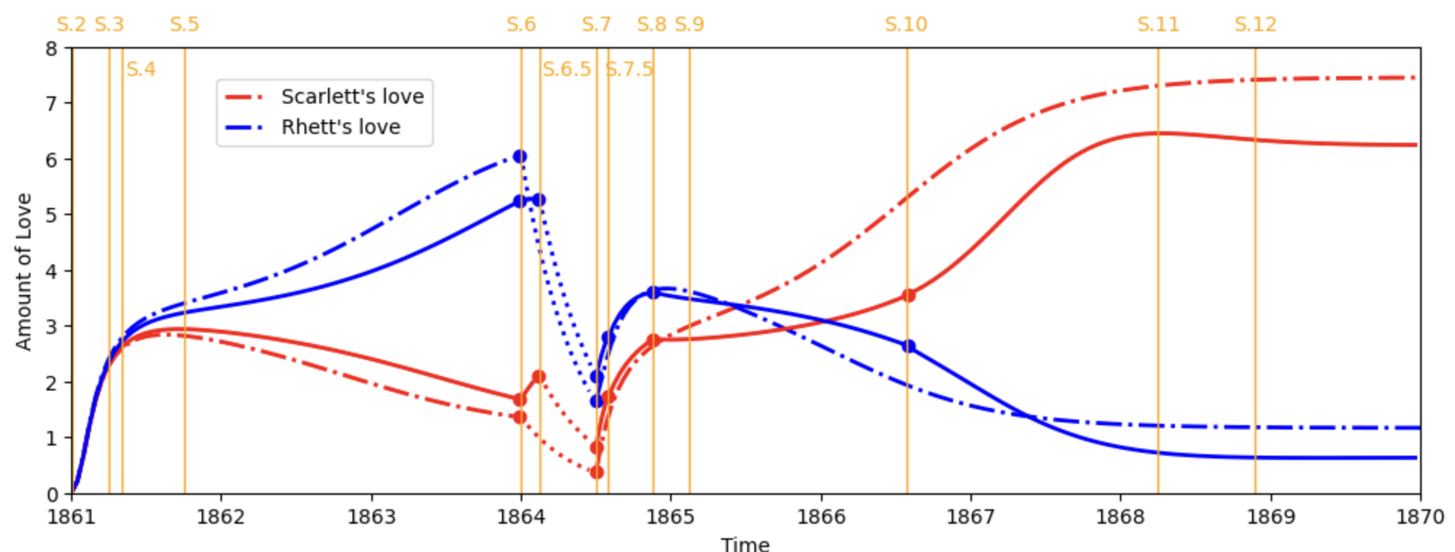
Limitation & Improvement
New Model vs Old Model:
Notes:
Here is a complete comparison between the trajectory generated by old model and our model.

Slide 24
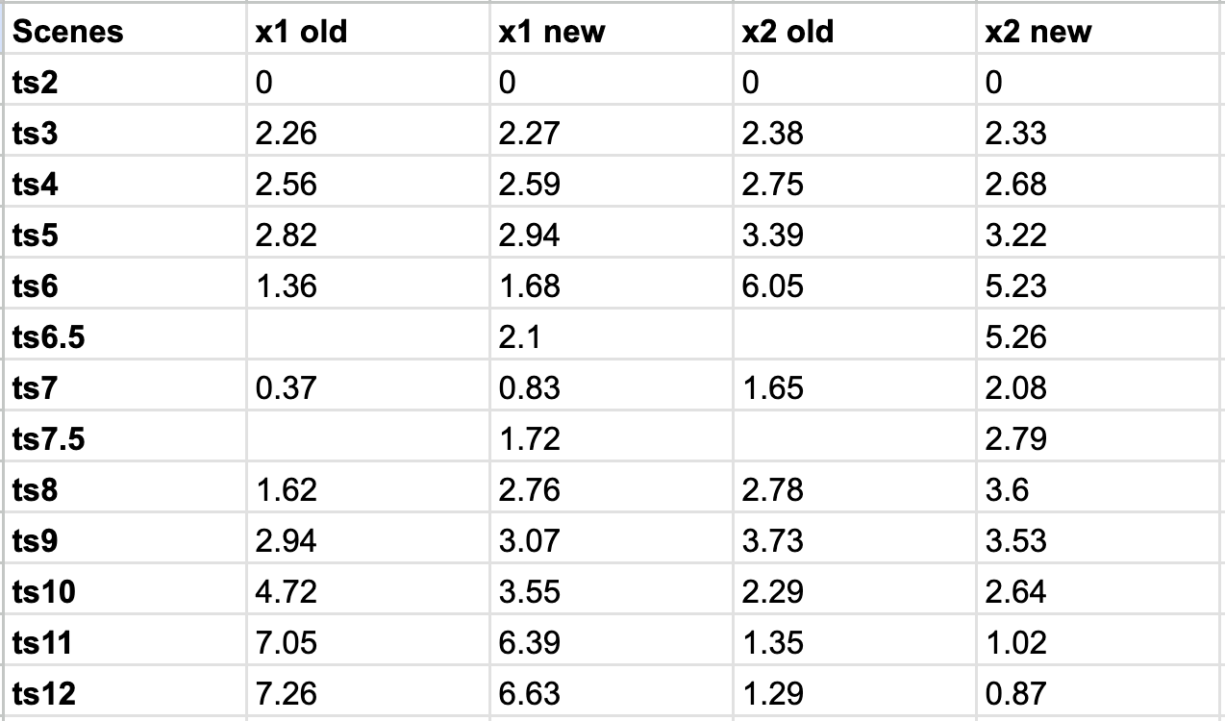
Limitation & Improvement
New Model vs Old Model:
Notes:
And here are the exact values for the amount of love at each time point.

Slide 25
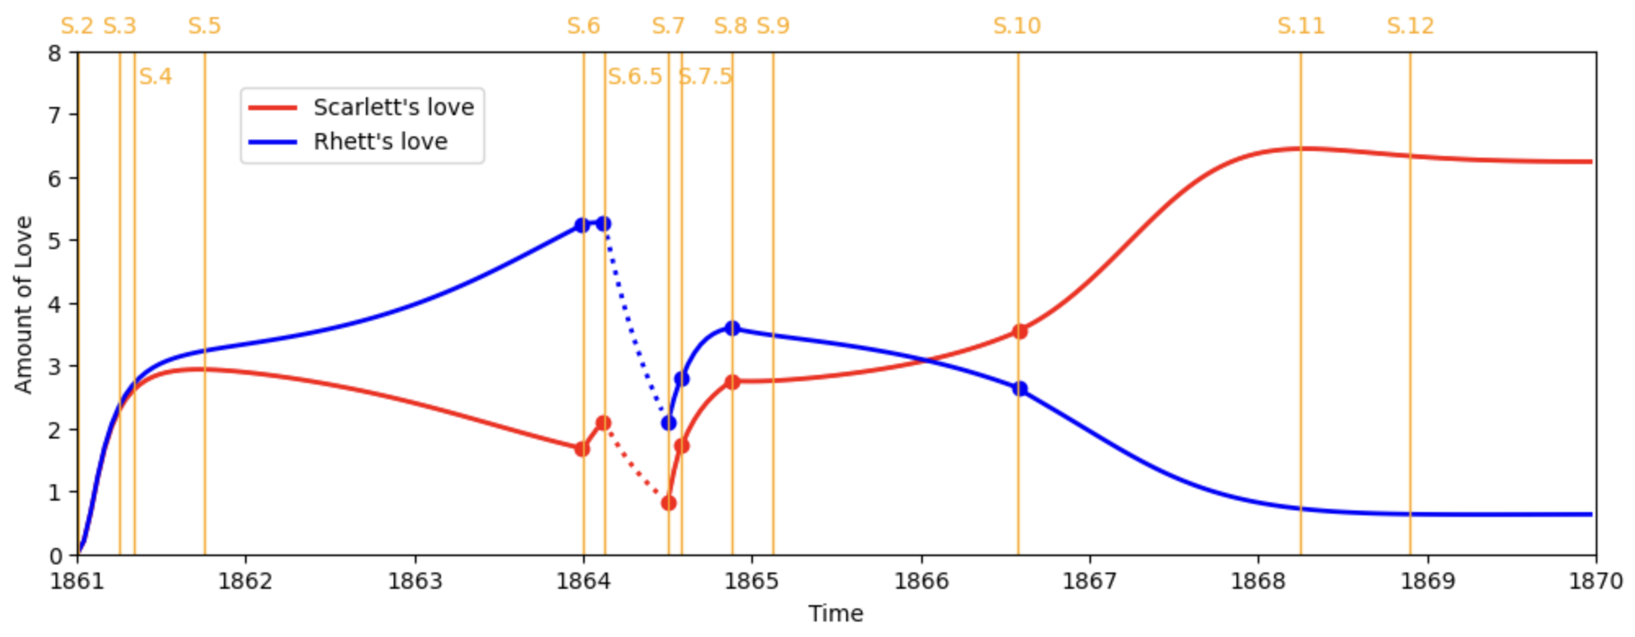
Limitation & Improvement
New Model:

Slide 26
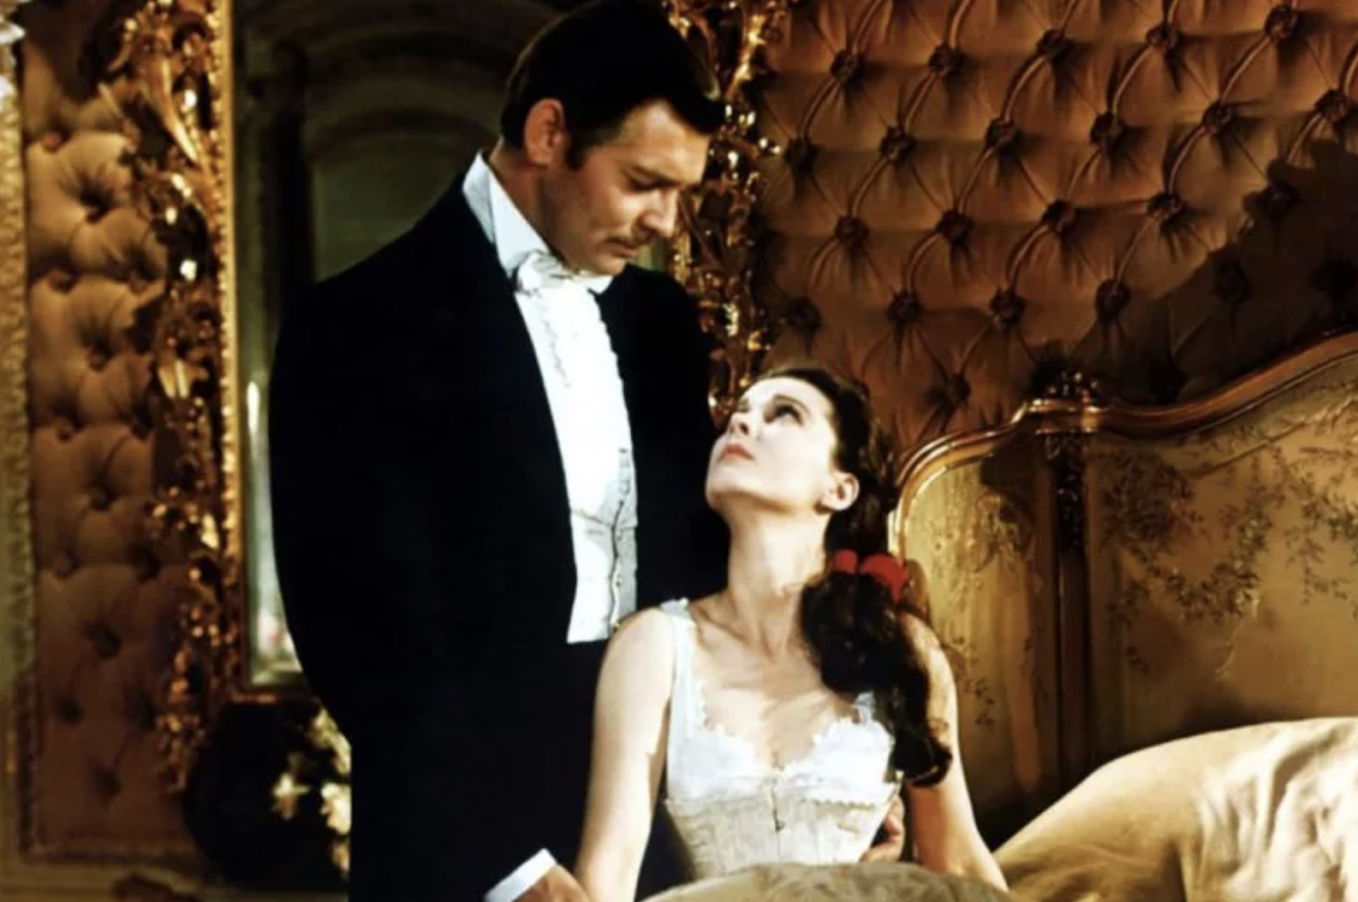
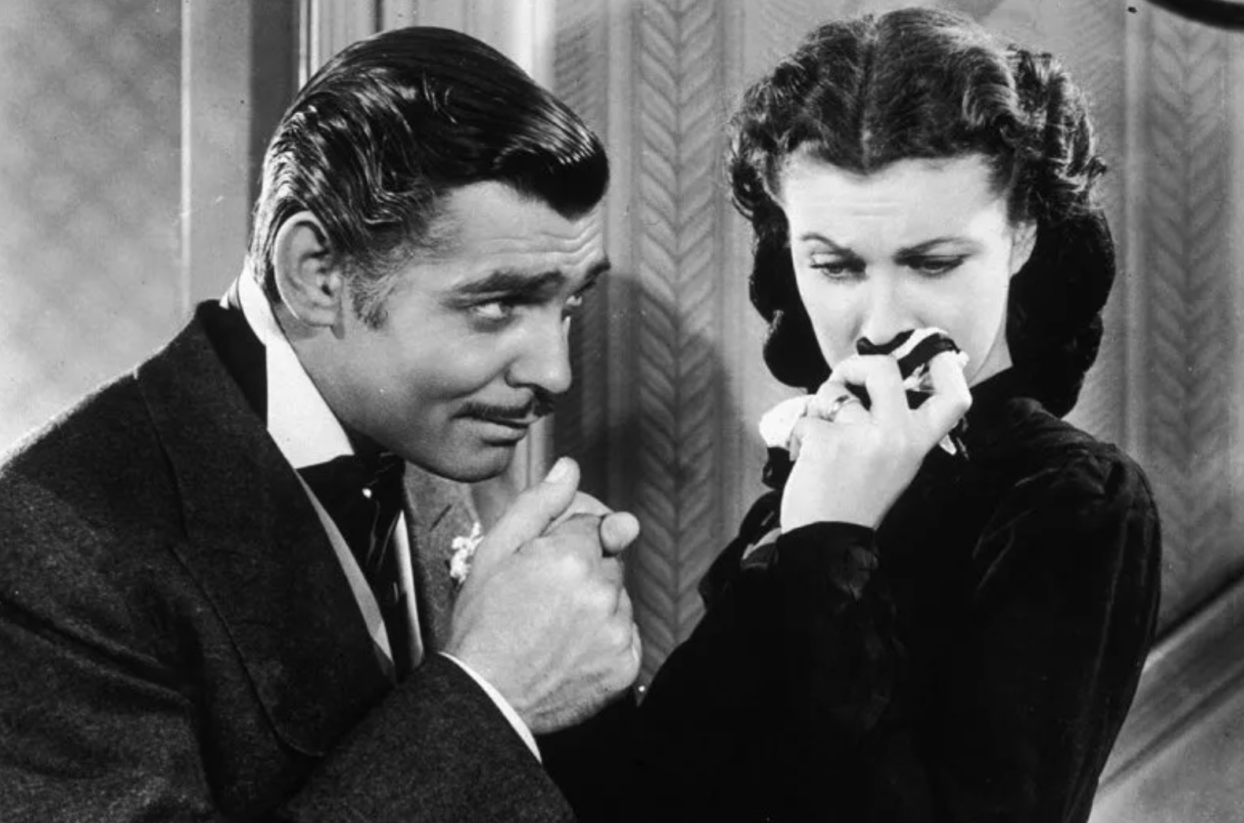
Discussion & Potential Improvement
Other parameters in the model’s ODEs can be modified as well:
αi (forgetting coefficient) – the authors assume αi is constant throughout the time, but we can try to assign different values on different time intervals and see what will happen;
ki and βi (coefficients in Ri)– the authors only give values of these two parameters with no further explanation about these terms’ meaning and why do they take those values;
Extra components for Ai to be added, such as the effect of environment to their love.
More plots to be included – For example, Scarlett may have a bad first impression on Rhett since Rhett happened to oversee Ashley rejecting Scarlett's advances shortly after their first meet, which may lead to a negative initial value for Scarlett’s love to Rhett and will have a huge impact on later evolution of their love.
Notes:
For potential improvements
We can change the coefficient alpha_i, beta_i, and k_i in different period after further studying their meanings.
And more plots can be included: for example, Scarlett has a bad first impression on Rhett, which may lead to a negative value for her love to Rhett at the beginning.
Other possible improvements of the model can be made by changing the values of the parameters, such as ai, which is the forgetting coefficient, ki and Bi, which are the parameters that define the value of Ri. Since the authors assume that ai remains constant throughout the entire story, we can try to change its value in different time intervals to see what changes will occur in the development of the story. For ki and Bi, the authors only give their values without explaining what they represent or where they come from. In addition, we can take more factors into consideration for Ai, such as how the environment affects their love. And finally, more plots can be included. For instance, when Scarlett notices that Rhett happens to see Ashley rejecting her after she first met Rhett, she might have a negative feeling for Rhett, which leads to a negative initial value for Scarlett’s love to Rhett and will have a huge impact on later evolution of their love.
We can change the forgetting coefficient in different period after studying further of their meanings
More plots can be included for example Scarlett has a bad first impression on Rhett

Slide 27
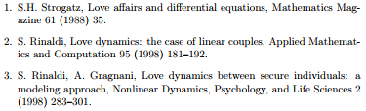
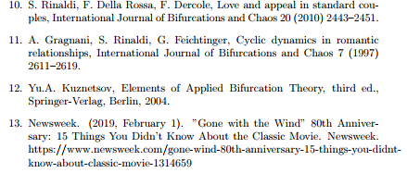
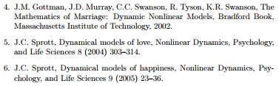
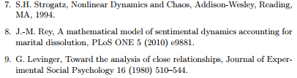
References
Notes:
This is our reference! Thank you!

Slide 28
December, 2023

